Slide 1
COMPARATIVE ANALYSIS OF IL1B FOR DIFFERENT STAGE OF CERVICAL CANCER USING ANTI-PAPILLOMA VIRAL DRUGS.
Enhanced with machine learning to uncover gene-stage correlations and automate early-stage drug screening workflows.
Guide: MS. Samiksha Garse
Student Name: Namandeep Singh Nayyar
Roll No. BID-19009

Slide 2

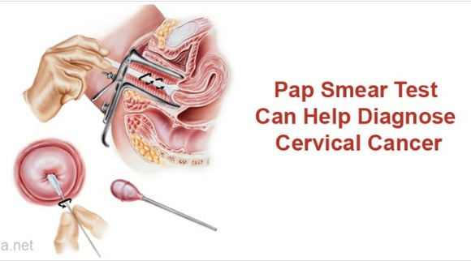
Introduction
Defination: Cervical cancer is a type of malignancy that starts in the cells of the cervix, which is the lower part of the uterus that connects to the vagina. It primarily affects sexually active women between the ages of 30 and 45.
Cause: The primary cause of cervical cancer is the Human Papillomavirus (HPV), a sexually transmitted infection. Not all types of HPV cause cervical cancer, but certain high-risk strains like HPV 16 and 18 are the most common ones linked to this disease.
Screening and Prevention: Screening tests like the Papanicolaou (Pap) test and the HPV DNA test can help detect precancerous conditions of the cervix, thus preventing the development of cervical cancer.
[1]https://www.medindia.net/patients/patientinfo/cervical-cancer-symtoms-and- diagnosis.htm

Slide 3
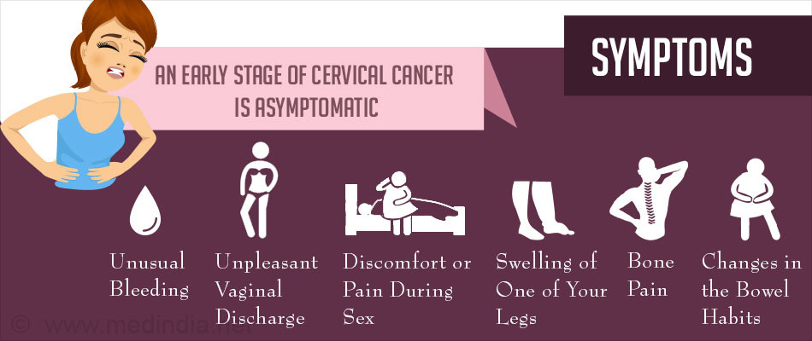
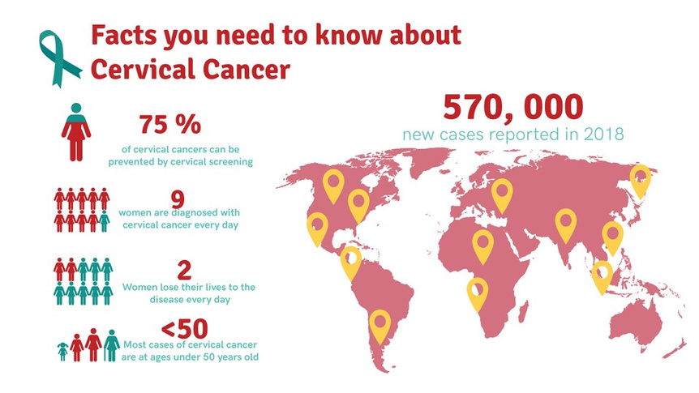
Symptoms and Diagnosis
Global Impact
[1]https://www.medindia.net/patients/patientinfo/cervical-cancer-symtoms-and-diagnosis.htm
[2]https://www.abacare.com/blog/tag/cervical-cancer/
Prognosis and Survival Rates While cervical cancer is a serious disease, it is also one of the most successfully treatable forms of cancer if detected early. Survival rates vary depending on the stage at diagnosis, with a 5-year survival rate of over 90% for localized cases.

Slide 4
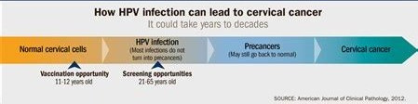
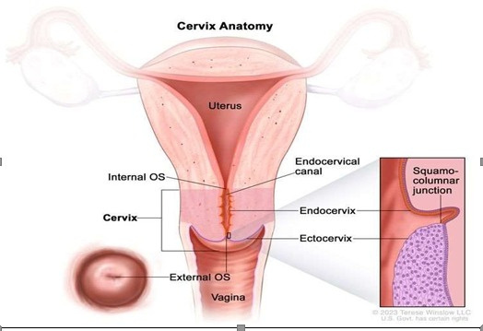
[3] https://www.cdc.gov/vitalSigns/cervical-cancer/
The border where the endocervix and ectocervix meet is known as squamocolumnar junction. Most cervical cancers begin here
[4]https://www.cancer.gov/publications/dictionaries/cancer-terms/def/endocervix

Slide 5
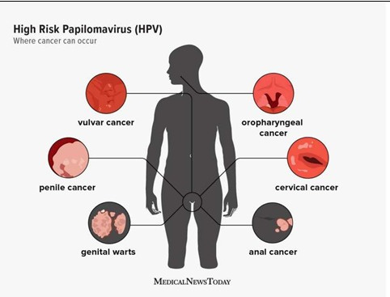
Human papillomavirus (HPV)
The Human Papillomavirus (HPV) is a group of more than 100 related viruses, each identified by a type number. They are called papillomaviruses because some of them cause warts, or papillomas. Some types of HPV are considered high risk because they can lead to specific types of cancer. HPV Transmission HPV is the most common sexually transmitted infection (STI) and is spread through vaginal, anal, or oral sex.
High-risk HPV types, notably types 16 and 18, can result in the development of cervical, anal, oropharyngeal (throat), penile, vaginal, and vulvar malignancies even though the majority of HPV types have no symptoms and go away on their own. Genital warts can be brought on by HPV types 6 and 11, which are considered low-risk.
[5] https://www.medicalnewstoday.com/articles/high-risk-hpv#prevention

Slide 6
LITERATURE REVIEW
IL1B
Interleukin-1 beta (IL-1B) is a pro-inflammatory cytokine, a type of signaling molecule in the immune system. It is primarily involved in the mediation of inflammatory responses, but its role extends to a variety of other biological functions. IL-1B plays a significant role in cell proliferation, differentiation, and apoptosis - processes that are intimately linked to cancer development and progression.
In the context of cancer, IL-1B has been implicated in promoting tumorigenesis, tumor
growth, and metastasis. It contributes to a pro-tumorigenic environment by inducing
inflammation, angiogenesis (the development of new blood vessels that supply the
tumor with nutrients), and by assisting in immune evasion by the tumor.
Several types of cancers have been associated with elevated levels of IL-1B, including
lung, breast, colon, gastric, and ovarian cancers.
[6]Rébé, C., & Ghiringhelli, F. (2020). Interleukin-1β and Cancer. Cancers, 12(7), 1791.
https://doi.org/10.3390/cancers12071791
IL1R is a receptorthat binds to the cytokineInterleukin 1 beta . When IL1R binds to IL1b, it
triggers a signaling cascade that leads to the upregulation of IL1b expression.
[7]Lappano, R., Talia, M., Cirillo, F., Rigiracciolo, D. C., Scordamaglia, D., Guzzi, R., Miglietta, A. M., De Francesco, E. M., Belfiore, A., Sims, A. H., & Maggiolini, M. (2020). The IL1β-IL1R signaling is involved in the stimulatory effects triggered by hypoxia in breast cancer cells and cancer-associated fibroblasts (CAFs). Journal of experimental & clinical cancer research : CR, 39(1), 153. https://doi.org/10.1186/s13046- 020-01667-y

Slide 7
Aim: To identify important genes(IL1B) from the cervical cancer dataset, study its mechanism and the protein-ligand, protein-protein interaction of those genes followedby MD simulation Objectives: ➢ To identify the important genesinvolved in Cervicalcancer at differentstages. ➢ To identify functionalities and mechanism of the important genes(IL1B). ➢ To understand the interactionbetween Interleukin - 1 Beta and Type-1interleukin-1 receptor ➢ To identify drugs and diseasesinvolved with the genes. ➢ To study the interaction between Interleukin - 1 Beta and Type-1 interleukin- 1 receptor (1ITB)complex with different Chemical Compounds.
Aim and Objectives

Slide 8
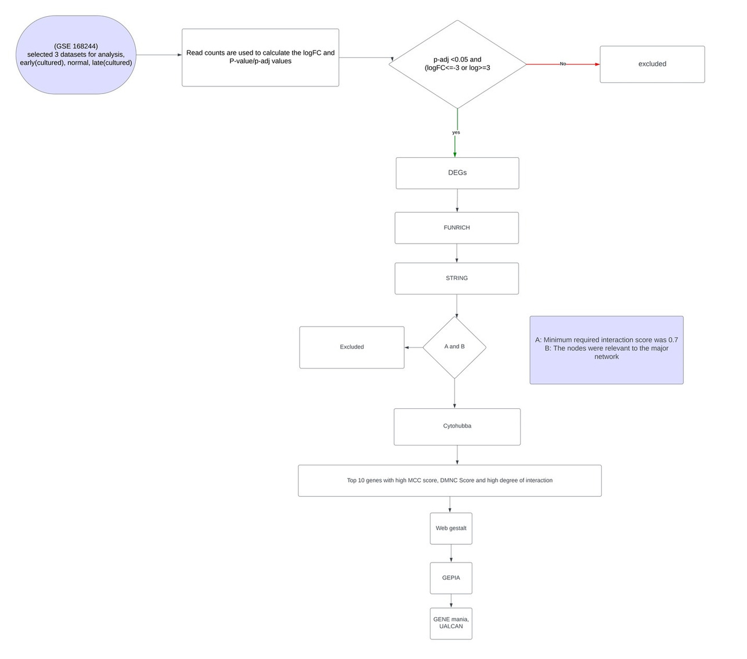

Slide 9
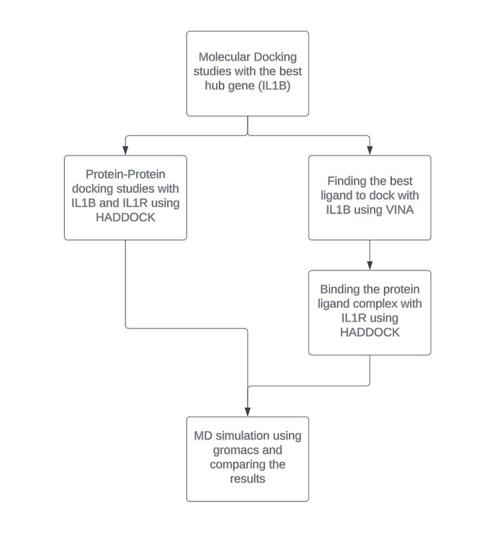

Slide 10
Results:
•Control vs test – Selecting samples taken from normal and tumorous tissue
•Early passage – Selecting samples / cells that have been cultured for a relatively short amount of time and have undergone few rounds of cell division
•Late passage – Selecting samples / cells that have been cultured for a longer period and have undergone many rounds of cell division.

Slide 11
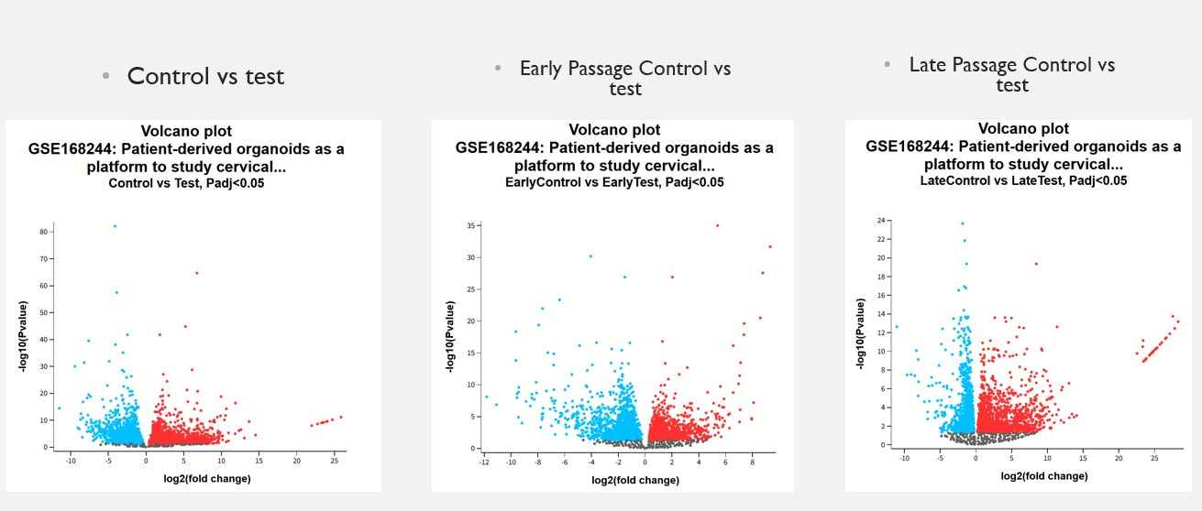
DEG/volcano plots

Slide 12
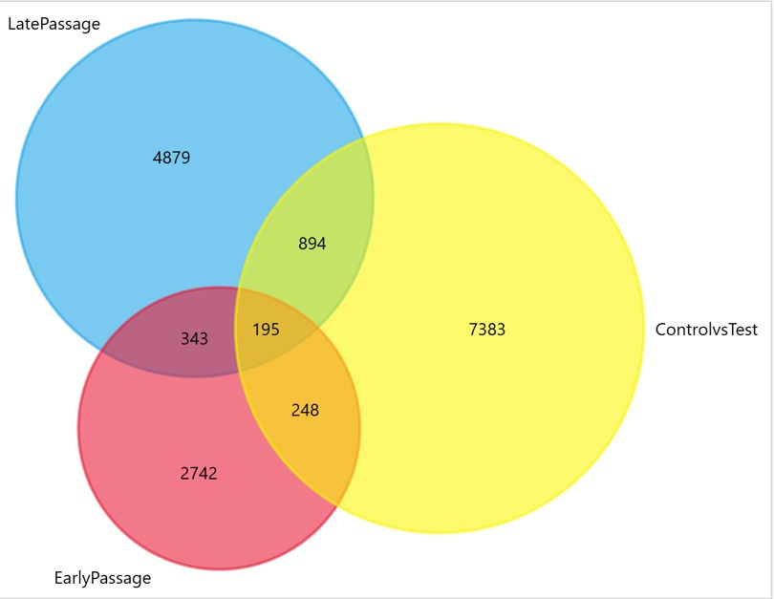
Common genes venn diagram using funrich

Slide 13
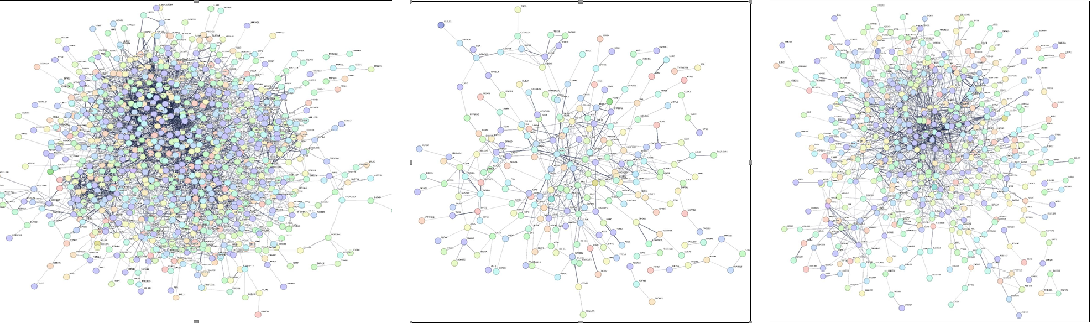
PPI Networkconstruction: STRING network of all significant upregulated and downregulated DEGs
control vs test 1124 genes
Early control vs test 397 genes
late control vs test 727genes
Genes were uploadedto construct the network. The nodes having no interaction were
eliminated and only those with interaction and clusters are displayed.

Slide 14
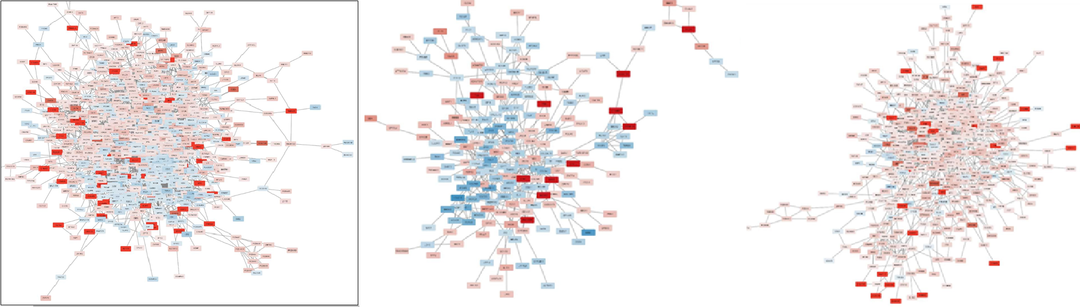
Key gene analysis:
control vs test
Early control vs test
late control vs test
The STRING network was imported to CytoScape and the genes were colored to show the intensity of the up or down regulation, also the edges were weighted (thickened) based on their connectivity.

Slide 15
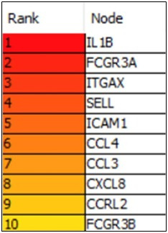
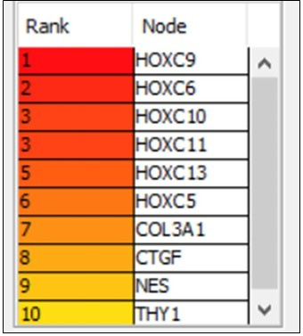
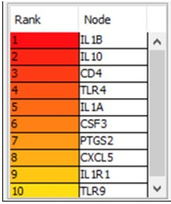
Utilizing the CytoHubba plugin, we calculated the MCC, identifying the top 10 genes. We then used MCODE for validation of MCC. The common genes across all data sets were selected for further study. From this, IL1B stood out as our primary hub gene, scoring highest in both late passage and common genes.
control vs test
Early control vs test
late control vs test

Slide 16
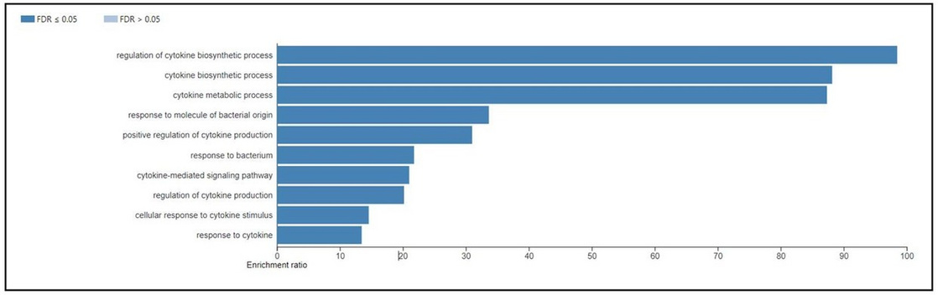
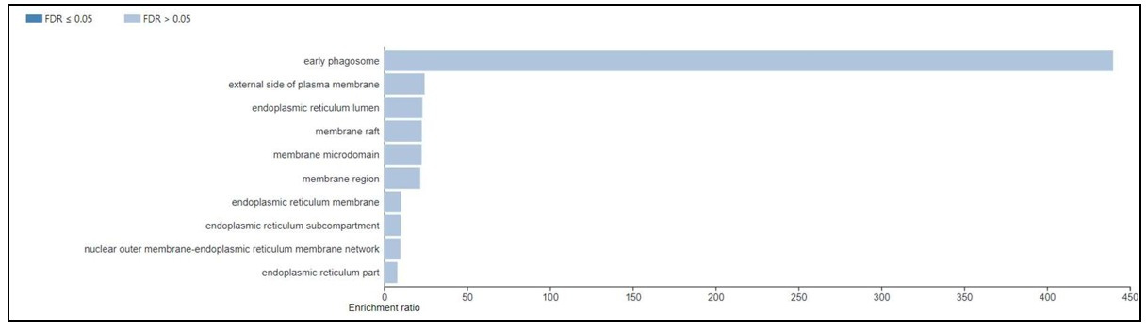
Enrichment analysis of the key genes:
Biological process
This term suggests that the hub genes are primarily involved in controlling the production of cytokines, which are critical proteins for cell signaling. This regulation could play a role in immune responses, inflammation, and cancer progression in cervical cancer.
Cellular components
Our data points to a significant involvement of the hub genes in early phagosomes, which are key components in the process of phagocytosis (cell "eating"). This can influence how cells interact with their environment, including defense against pathogens and potentially tumor growth.

Slide 17
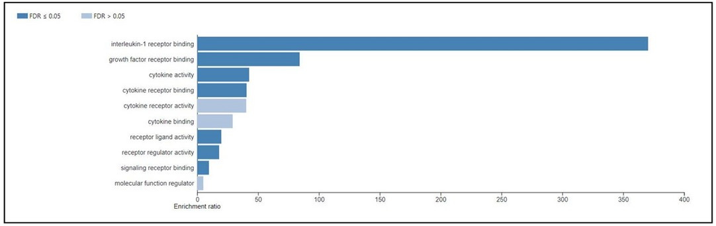
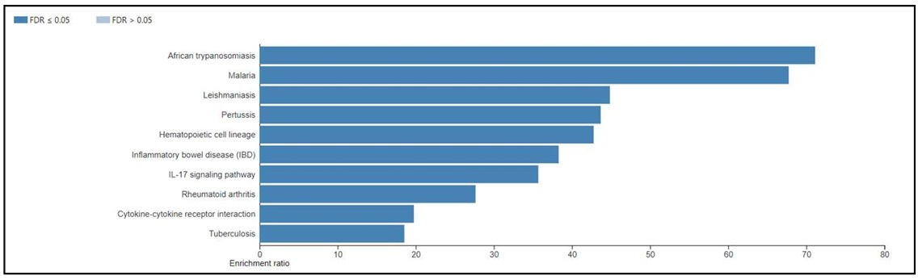
Molecular functions
The top genes have a high affinity for binding to Interleukin-1 receptors. Interleukin-1 is a potent pro-inflammatory cytokine, and its activity has been associated with tumorigenesis and progression in various cancers.
KEGG Pathways
The major pathway associated with the hub genes is African trypanosomiasis. Although this pathway is primarily related to a specific parasitic disease, it might highlight key immune responses or metabolic pathways co-opted in cervical cancer.

Slide 18
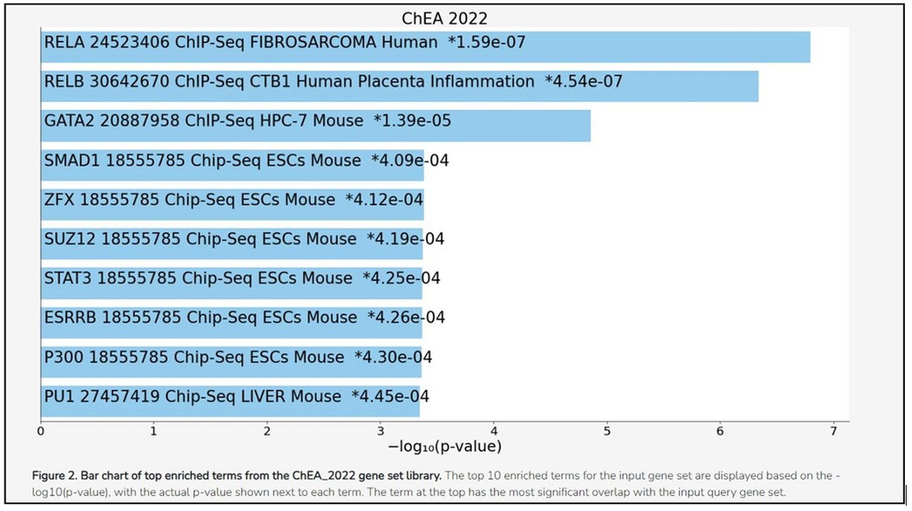
Enricher analysis
Enrichment analysis using the ChEA 2022 gene set library indicates a significant association with fibrosarcoma. Although fibrosarcoma is a different type of cancer, the shared gene expression patterns might reflect common underlying biological processes or pathways in tumor development and progression.

Slide 19
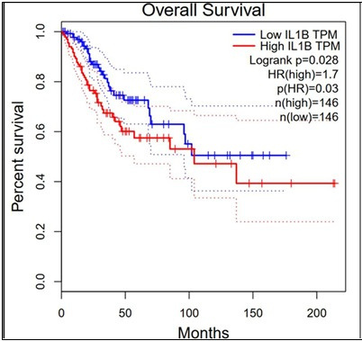
Survival analysis using GEPIA
The Hazard Ratio (HR) of the high IL1B expression group compared tothe low expression group was calculated to be 1.7 with a p-value of 0.03, furtherindicating statistical significance. A HR valuegreater than 1 implies that the event(in this case, death) is more likely to occur in the high expression group, supporting the finding that high IL1B expression is associated with poorer overallsurvival in cervicalcancer patients.

Slide 20
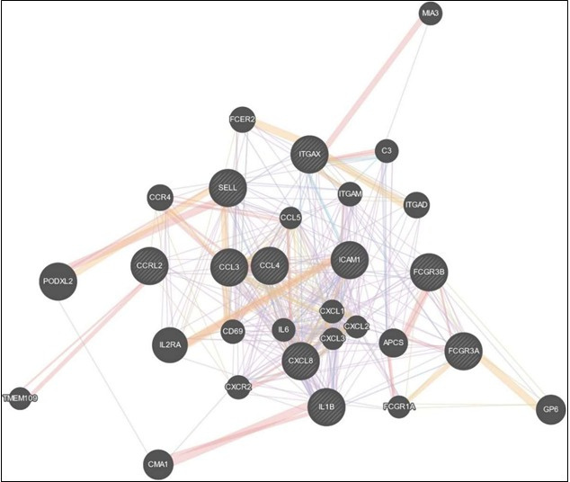
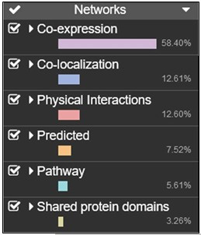
Hub gene validation
Using Gen
eMANIA
We were able to identify numerous sorts of interactions among our hub genes as a result of this investigation.
Co-expression relationships are generated from gene expression
data and indicate that certain genes are frequently expressed concurrently in the same cells or tissues, implying that they may collaborate in the same biological processes or pathways. . Co-localization implies that our hub genes are in the same cellular compartments, possibly performing similar biological activities. Physical interactions showing that the proteins encoded by the hub genes have direct molecular contacts. This could imply that these proteins belong to the same protein complex or that they interact directly during their function. The predicted interactions are based on machine learningtechniques that anticipate gene interactions from a varietyof data sources. Pathway-based interactions demonste that our hub genes are involved in similar biological pathways, emphasising their potential cooperation in specific biological activities. Finally, shared protein domains indicate that several of our hub genes encode proteins with comparable structural characteristics, implying similarfunctional roles in the cell.
Interactive gene-genefunctional interaction network
Percentage breakdown of the network'sinteractions

Slide 21
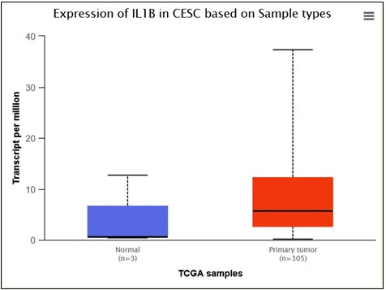
Using UALCAN
In the boxplot for IL1B, the x-axis represents the type of TCGA samples used, while the y-axis indicatesthe expression level of IL1B in termsof Transcripts Per Million (TPM). The boxplot presents two categories: 'Normal' (blue boxplot) representing gene expression in normal cervicaltissues (n=3), and 'Primary Tumor'(red boxplot) representing gene expression in CESC tissues (n=305).

Slide 22
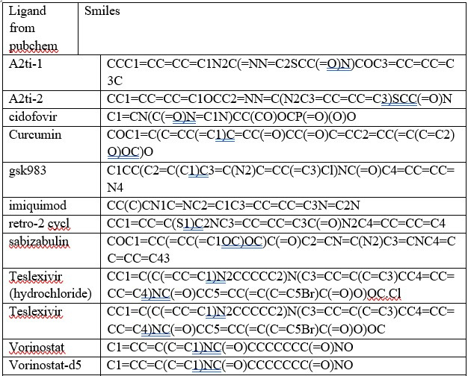
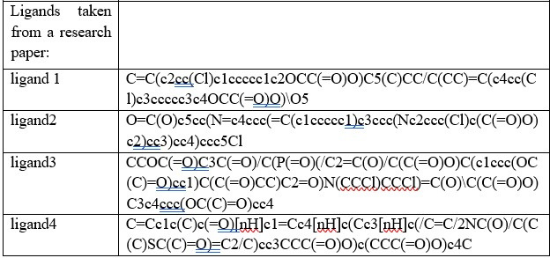
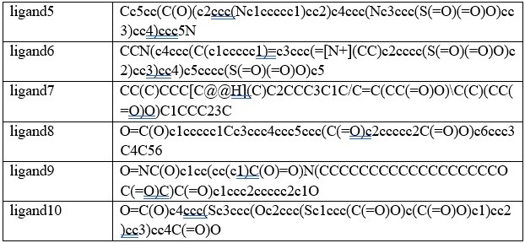
Ligand discussion
t
We used these smiles notations and got the ligand using pubchem or chemsketch.

Slide 23
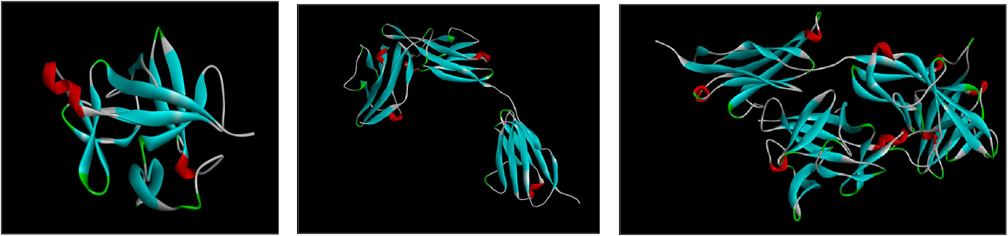
IL1B – modelled and energy minimized in swiss model and gromacs
IL1R – modelled and energy minimized in swiss model and gromacs
IL1B-IL1R Complex after Haddock
We know interaction between IL1B and 1ILR helps in up regulation of IL1B, We did molecular docking experiments on the interaction between IL1B and its receptor IL1R
This cluster's HADDOCK score was -83.3 +/- 11.6, which is the weighted sum of severalenergy terms such as van der Waals, electrostatic, desolvation, and constraint violation energy. A lower score suggestsa better matchbetween the two proteins

Slide 24
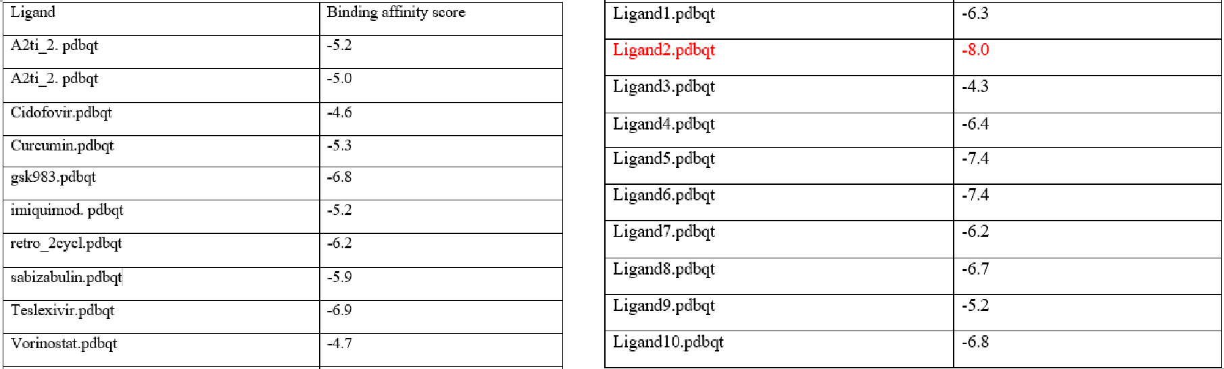
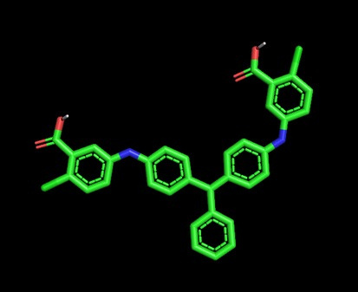
Protein ligand docking
Binding affinity score betweenIL1B and HPV drugs
Chemical name of ligand 2: 5-[[4-[[4-[(3-Carboxy-4-chlorophenyl)amino]phenyl]phenylmethylene]-2,5- cyclohexadien-1-ylidene]amino]-2-chlorobenzoic acid

Slide 25
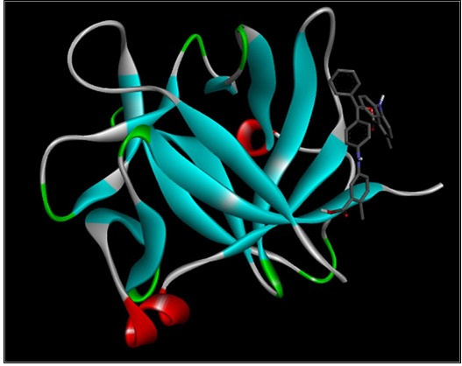
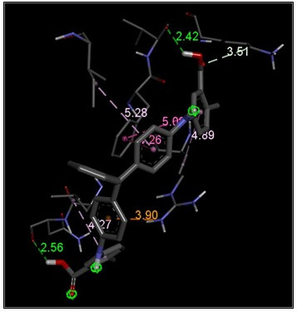
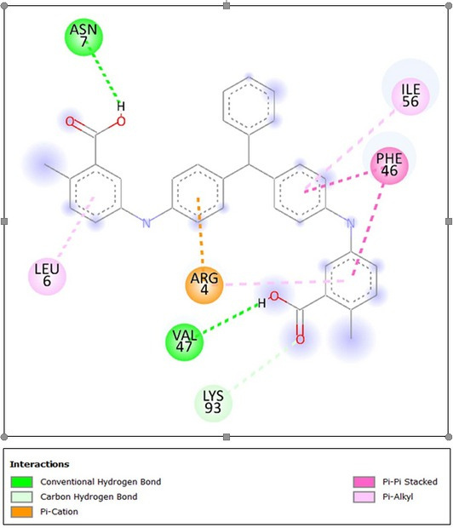
2D interactions with their respective color code
interactions with distances of the bonds
Protein ligand docking
Name of the interaction
Interface Amino acid residues
Conventional Hydrogen Bond
ASN 7, VAL47
2D interactions
Carbon Hydrogen Bond
LYS 93
table
Pi-Cation
ARG 4
Pi-Pi stacked
PHE 46
Pi-Alkyl
ILE 56, LEU 6

Slide 26
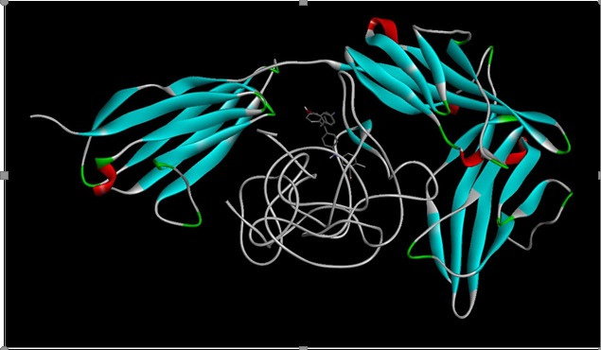
protein- ligand- protein docking
This complex's HADDOCK score was 21.0 +/- 7.4, indicating a less favourable interaction than the IL1B-IL1R complex, as shown by the positive score.
Protein-ligand-protein complex

Slide 27
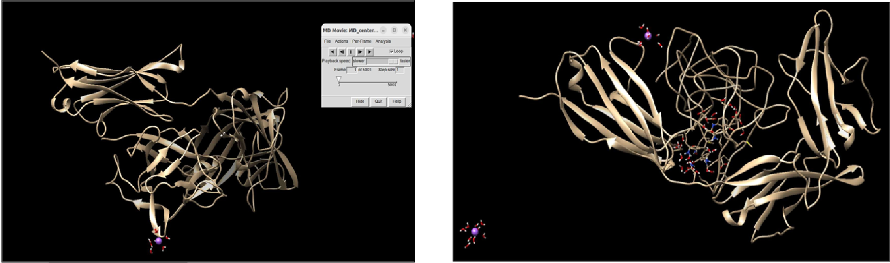
MD Simulation
Protein protein Initial
Protein ligand protein Initial

Slide 28
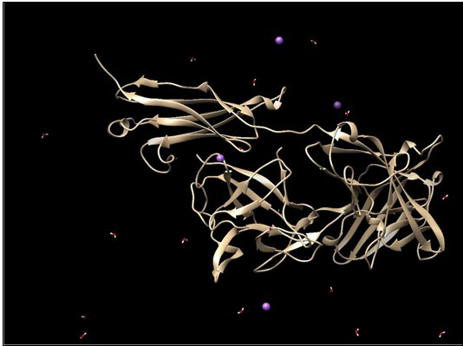
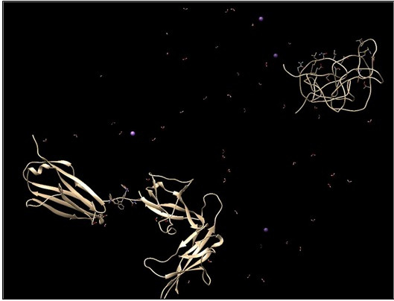
Protein protein final
Protein ligand protein Final
From the image we can see
that the two proteins are still
intact
From the image we can see that
the Ligand has separated the two
proteins (IL1R on the left and IL1B on
the right)

Slide 29
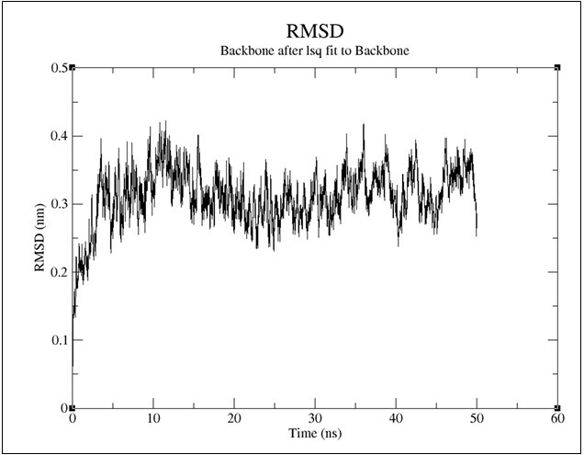
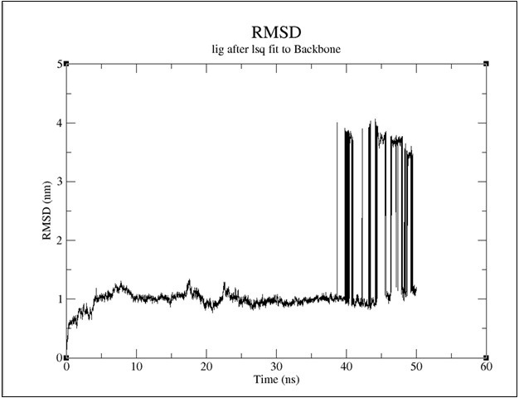
Protein protein RMSD
Protein ligand protein RMSD
No sudden high dips
and jumps in the
graph meaning the
two proteinsare stable
The rmsd graph shows that the ligand was stable in the
first 38 ns then the rmsd shot up and was inconsistent as
the two proteins separated and the ligand was no longer
stable. It shows that Ligand2 has the capacity to break
the IL1B-IL1R interaction.

Slide 30
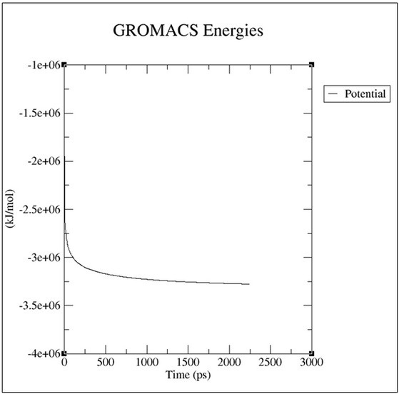
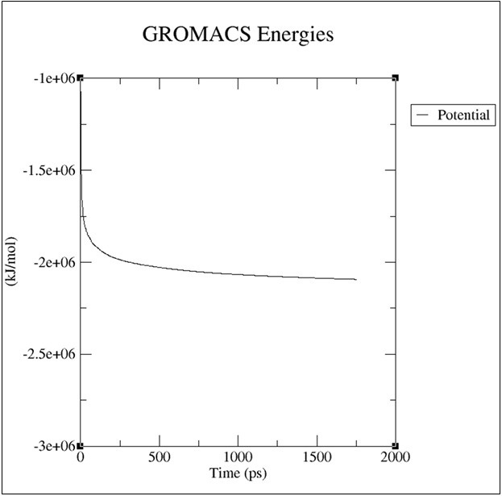
We have also generated graphs for the system's potential, temperature, and pressure across the simulation time. The potential energy graph indicates the stability of the system over time, with less variation suggesting a more stable system. The temperature and pressure graphs were scrutinised to confirm that thesimulation maintained the appropriate conditions throughout.
Protein protein complex
Protein Ligand protein complex
Energy graph, The re sulting plot demonstrates
nice,steady conversion of Epot. The average Epot
was -3.19994e+06
The averageEpot was
-2.03512e+06

Slide 31
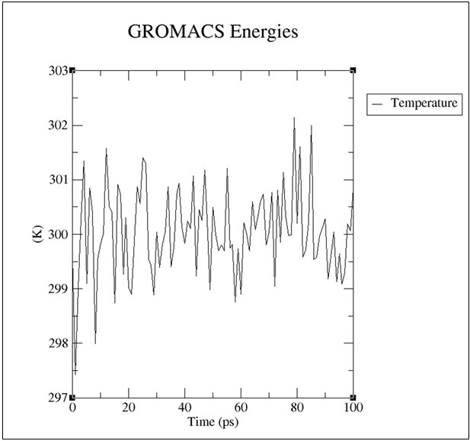
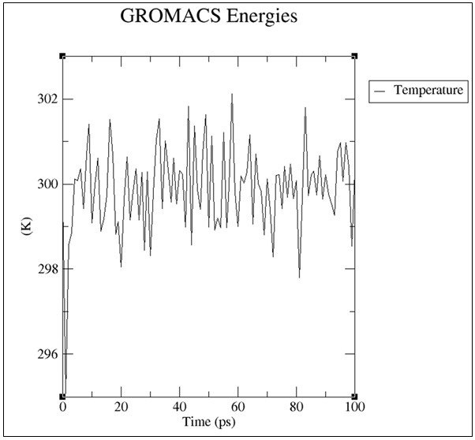
The average temperature was 299.7 (Protein protein complex)
Avg temp 299.77(Protein Ligand protein complex)

Slide 32
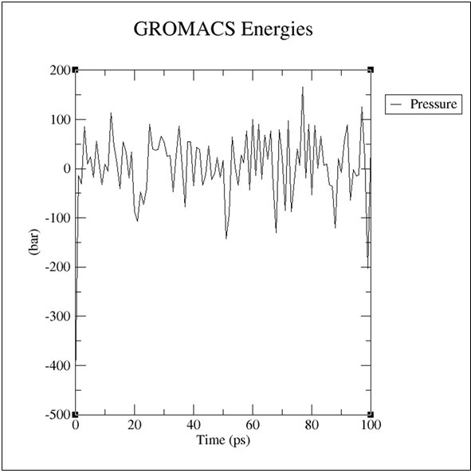
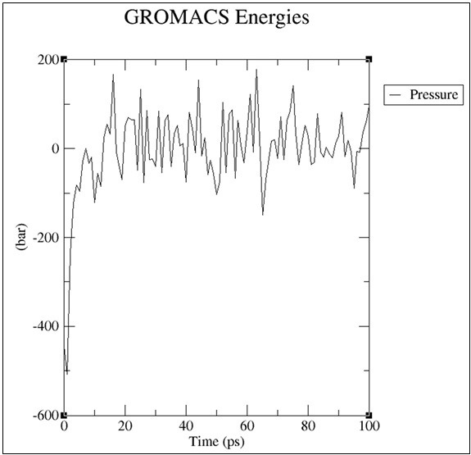
The averagepressure was -1.32467(Protein protein complex)
Avg pressure -11.5431(Protein Ligandprotein complex)

Slide 33
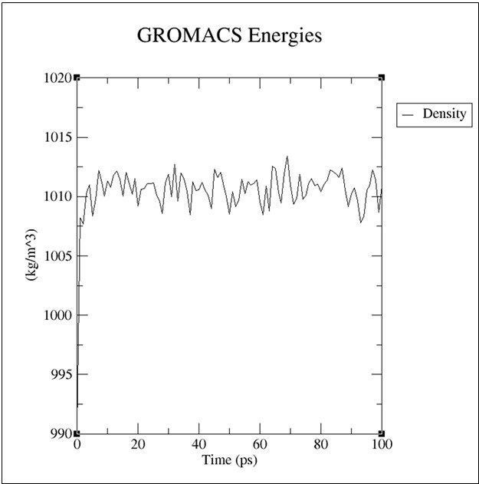
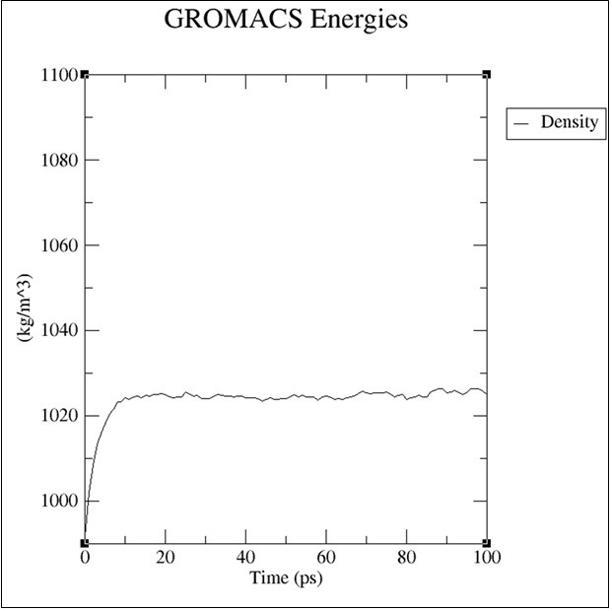
The averagedensity was 1010.56(Protein protein complex)
Avg density1023.75(Protein Ligand protein complex)

Slide 34
Conclusion
This research utilized the GSE168244 dataset to pinpoint IL1B as a significant gene in cervical cancer cells from late passages. The function of the IL1B gene is often associated with inflammatory and immune responses, both of which have strong links to cancerdevelopment.
The use of an HPV-targeted drug as a ligand displayed potential to interrupt the interaction between IL1B and IL1R, which could subsequently result in the reduced expression of IL1B. This discovery suggests a new potential therapeutic strategyfor the management of cervical cancer.The dissociation of the IL1B-IL1R complex, after a certain period under the HPV drug, was verifiedusing Molecular Dynamics (MD)

Slide 35
These observations providehopeful prospects for the treatmentof cervical cancer.The strategy of specifically interfering with key protein-protein interactions, such as IL1B and IL1R, opens up possibilities for controlling centralcellular processes in cancer cells. The ability to suppress IL1B via this method couldpotentially have a significant impact on the generation of targeted cancertherapies. Next steps in this research should involve in vitro and in vivo validation of these computational results, with the ultimate goal of moving towards clinical trials if successful. This work emphasizes the significant role that bioinformatics and structural biologyplay in enhancing our understanding of cancer development and in findingeffective treatment strategies.

Slide 36
Leveraging machine learning to identify gene-stage patterns and accelerate early drug discovery through automated analysis.
• Designed and implemented a machine learning–powered pipeline to investigate the role of the IL1B gene in the progression of cervical cancer. Leveraged classification algorithms to identify stage-specific gene expression patterns and determine IL1B's significance in disease development.
• Combined this ML-driven analysis with a fully automated bioinformatics workflow that allows users to upload drug and protein structures. The system then initiates a sequence of molecular docking and simulation steps, automating what is typically a multi-tool, manual process.
• The machine learning component guided the selection of drug targets more effectively and added an intelligent layer to the drug screening process — enabling smarter prioritization of candidate compounds.
• This integration of ML with automation reduced overall workflow time by approximately 20%, minimized human error, and created a scalable framework for future gene-drug interaction studies and early-stage drug discovery in oncology.

Slide 37
Future Work
Here are some possibilities: 1. Look into the signalling pathways involved in the IL1B-IL1R interaction: It would be useful to look into the downstream signalling pathways that are activated when IL1B binds to IL1R. This might comprise the NF-kB, MAPK, or other pathways. Identifying important intermediates in these pathways may provide new treatment targets. 2.Create potential inhibitors: Using your understanding of the relationship between IL1B and IL1R, you may build or uncover potential inhibitors that could disrupt this interaction. Once candidate inhibitors have been identified, they may be tested in vitro using cell-based assays and in vivo in appropriate animal models. 3.Cross-cancer comparison: one might also extend your investigation to other forms of cancer to see if IL1B has a function there as well. A pan-cancer investigation might shed furtherlight on the generalizability of your findings.

Slide 38
4.Comprehensive Structural Analysis: Conduct furtherstructural research of the IL1B- IL1Rcomplex. Examine whetherthere are any other potentialplaces on the protein complex that may be targeted in order to decrease the connection. For this type of investigation, molecular dynamic simulations might be useful. 5.Clinical trials: Once you have a solid basis for preclinical research, you may begin arranging clinicaltrials. This would entail workingwith physicians and other researchers to create a trial, obtainethical permission, and begin testingyour treatment technique on patients. This would be a long-term goal, as clinicalstudies can take several years to plan and execute.

